Slide 1
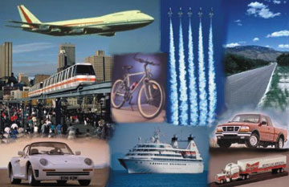
TEAM 4
Andrew
Du
Roberto
Sundar
Tam Tran
Client:
John Winder
Notes:
Good evening ladies and gentle man. This is team 4 aka team awesome, the A team….

Slide 2
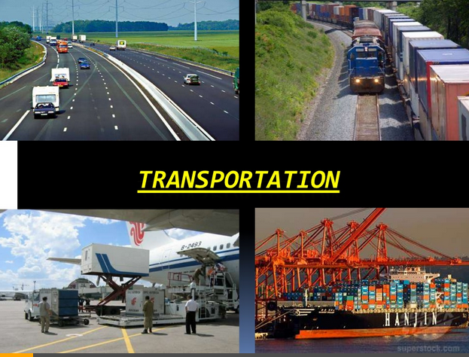
Notes:
Transportation is a big problem in USA. How many people live in DC? It takes more than 2 hours just to drive 22 miles on 495. It’s a trillion dollar industry. Transportation means include road, water, rail and air. For now the fastest means of travel is by air unless you are kirk and spock who can beam themselves with the teleportation device.

Slide 3

Modes of Transportation
Notes:
Let me ask you a question how many of you drive to college? How many of you have taken a ride on a metro? What if you want to attend the premier of Avengers age of ultron in California but you cant get the tickets to fly there? What if you want to go on a honeymoon with a limited budget? Or if you want to hangout with some you just met on facebook, twitter or tinder but lives in west coast? Most of the people have to wait or spend thousands of money to get want you want.
We said earlier that the fastest and the safest means of transportation is by air. So we capitalized on that. Ladies and gentleman what if we have the solution for all your problems. What if we created something that’s is simple and affordable for the people of united states of America?
One of the great mind Alan Key once said The best way to predict the future is to invent it. With out wasting anytime we present to you the future…. Planes for hire.

Slide 4
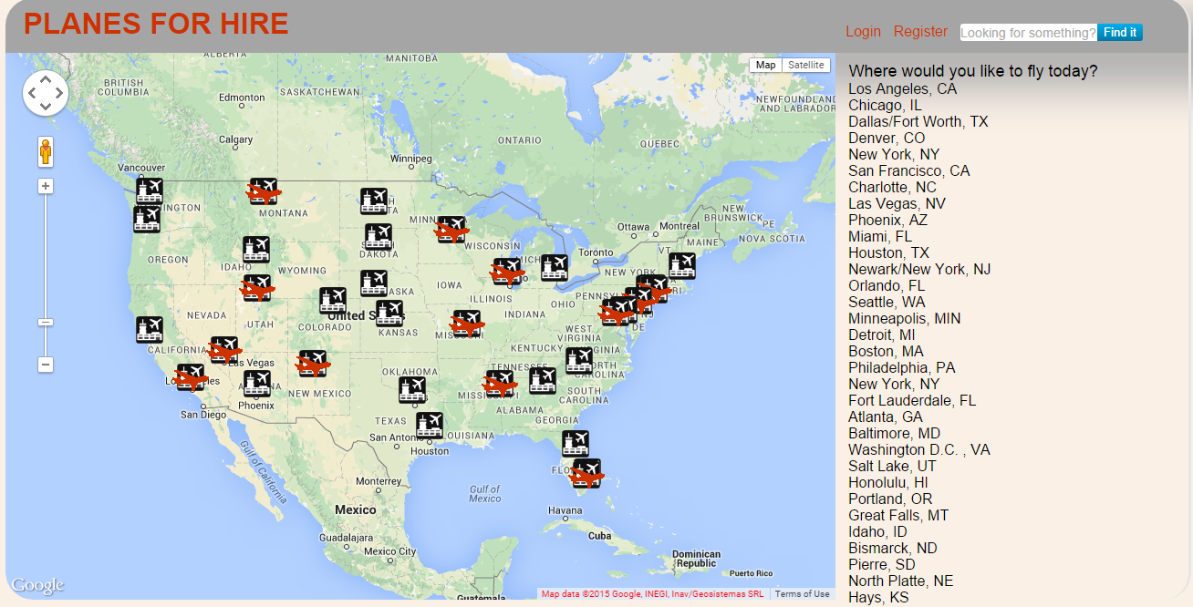

PLANES FOR HIRE
Notes:
We have created something so unique and simple that solves many problems that we have in everyday life. Time is money, we know you cannot afford to lose it. With a simple click of a button you can travel anywhere in the United states you can. The best part is at no cost at all. Yep you all heard it right. At no cost at all. You can all travel in this fancy, luxurious aircrafts that’s links most of the states for free.
My colleague here is going to explain to you how you can enjoy the ride with a click of a button.

